Slide 1


MS4S09
Introduction to Text Analytics
© University of South Wales

Slide 2
Plan for Week 2
Introduction to Text Analytics
Text Mining - Simple bag of words example
Text Mining – Martin Luther King example in R
Analysing Twitter Data in R
© University of South Wales

Slide 3
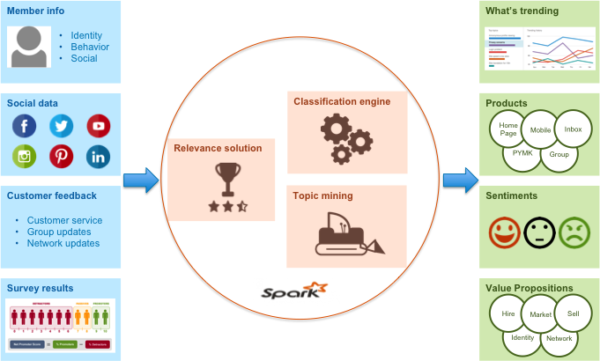
What is Text Analytics?
Text analytics techniques can be broadly classified as the following.
It is estimated that over 80% of the data in an organisation is text based.
© University of South Wales

Slide 4
Where is Text Analytics useful?
In recent year, text analytics has been heavily used for discovering trends in textual data.
Examples:
Crime
Healthcare
Customer feedback
© University of South Wales

Slide 5
What is Text Mining?
In a traditional sense, the term “text mining” is used for automated machine learning and statistical methods that encompass a bag of words approach.
This approach is typically used to examine content collections versus assessing individual documents.
Text Mining – the study of structural relationships between words
• Exploratory analysis
• Summarisation
• Categorisation
© University of South Wales

Slide 6
What is Text Mining?
In the case of text mining, we attempt to separate valuable keywords from a mass of other words (or relevant documents from a sea of documents) and use them to identify meaningful patterns or make predictions).
The fundamental step in text mining involves converting text into semi-structured data.
Once you convert the unstructured text into semi-structured data, you can apply a range of analytical techniques to classify, cluster and predict.
© University of South Wales

Slide 7
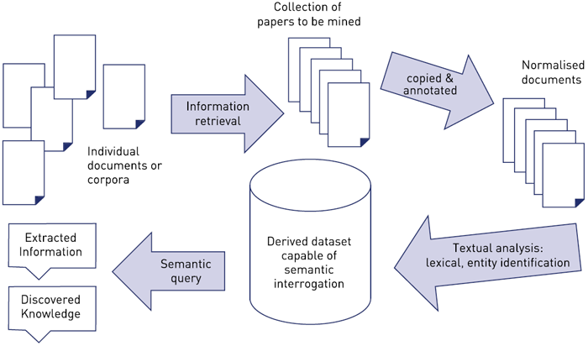
What is Text Mining?
© University of South Wales

Slide 8
Web Search Example
Consider a web search program where the user types in some keywords and the search engine extracts all the documents (essentially, web pages) that contain these keywords.
How does the search engine know which webpages to serve up?
In addition to using a page rank, the search engine also runs some form of text mining to identify the most relevant web pages.
© University of South Wales

Slide 9
Web Search Example
After entering keywords, the search engine runs on the following basic logic:
Give a high weighting to those keywords that are relatively “rare”.
Give a high weighting to those webpages that contain a large number of instances of the “rare” keywords.
What is a “rare” keyword?
© University of South Wales

Slide 10
Bag of Words Example
A bag-of-words model, or BoW for short, is a way of extracting features from text for use in modeling, such as with machine learning algorithms.
A bag-of-words is a representation of text that describes the occurrence of words within a document.
It involves two things:
A vocabulary of known words.
A measure of the presence of known words.
It is called a “bag” of words, because any information about the order or structure of words in the document is discarded. The model is only concerned with whether known words occur in the document, not where in the document.
© University of South Wales

Slide 11
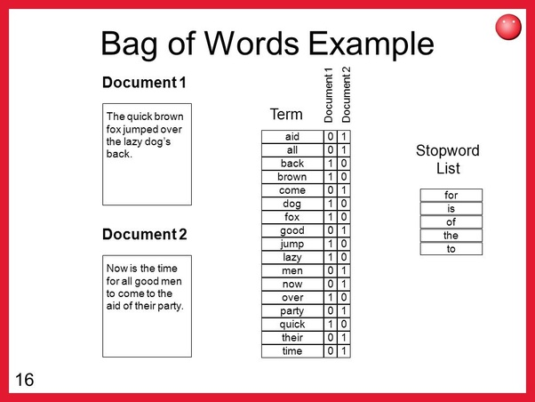
Bag of Words example
© University of South Wales

Slide 12
Bag of Words example
As the vocabulary size increases, so does the vector representation of documents.
You can imagine that for a very large corpus, such as thousands of books, that the length of the vector might be thousands or millions of positions. Further, each document may contain very few of the known words in the vocabulary.
This results in a vector with lots of zero scores, called a sparse vector or sparse representation.
Sparse vectors require more memory and computational resources when modeling and the vast number of positions or dimensions can make the modeling process very challenging for traditional algorithms.
© University of South Wales

Slide 13
Bag of Words example
There are simple text cleaning techniques that can be used as a first step to decrease the size of the vocabulary, such as:
Ignoring case
Ignoring punctuation
Ignoring frequent words that don’t contain much information, called stop words, like “a,” “of,” etc.
Fixing misspelled words.
Reducing words to their stem (e.g. “play” from “playing”) using stemming algorithms.
© University of South Wales

Slide 14
Bag of Words example
© University of South Wales

Slide 15
Bag of Words example
Below is a snippet of the first few lines of text from the book “A Tale of Two Cities” by Charles Dickens, taken from Project Gutenberg.
It was the best of times,
it was the worst of times,
it was the age of wisdom,
it was the age of foolishness,
For this small example, let’s treat each line as a separate “document” and the 4 lines as our entire corpus of documents.
© University of South Wales

Slide 16
Collect data
The bag-of-words model is very simple to understand and implement and offers a lot of flexibility for customization on your specific text data.
Nevertheless, it suffers from some shortcomings, such as:
Vocabulary: The vocabulary requires careful design, most specifically in order to manage the size, which impacts the sparsity of the document representations.
Sparsity: Sparse representations are harder to model both for computational reasons (space and time complexity) and also for information reasons, where the challenge is for the models to harness so little information in such a large representational space.
Meaning: Discarding word order ignores the context, and in turn meaning of words in the document (semantics). Context and meaning can offer a lot to the model, that if modeled could tell the difference between the same words differently arranged (“this is interesting” vs “is this interesting”), synonyms (“old bike” vs “used bike”), and much more.
© University of South Wales

Slide 17
Example in R
In the following example, we’ll process the
“I have a dream speech” from “Martin Luther King”
Example taken from http://www.sthda.com/english/wiki/text-mining-and-word-cloud-fundamentals-in-r-5-simple-steps-you-should-know
© University of South Wales

Slide 18
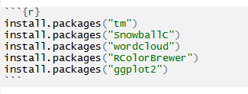
Loading the data
Step 1: Install packages and load libraries
Step 2: Import the data
© University of South Wales

Slide 19
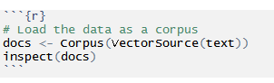
Building a corpus
Step 3: Load the data as a corpus
Let’s now build a corpus out of this vector of strings. A corpus is a collection of documents, but it’s also important to know that in the tm domain, R recognises it as a separate data type.
© University of South Wales

Slide 20
Pre-processing the data
Data cleansing, though tedious, is perhaps the most important step in text analysis. As we will see, dirty data can play havoc with the results.
Furthermore, as we will also see, data cleaning is invariably an iterative process as there are always problems that are overlooked the first time around.
The tm package offers a number of transformations that ease the tedium of cleaning data.
To see the available transformations type getTransformations() at the R prompt:
> getTransformations()
© University of South Wales

Slide 21
Transforming the data
Step 3: Transforming the data
Once we have a corpus we typically want to modify the documents in it, e.g., stemming, stopword removal. In tm, all this functionality is subsumed into the concept of a transformation.
Transformations are done via the tm_map() function which applies (maps) a function to all elements of the corpus.
Basically, all transformations work on single text documents and tm_map() just applies them to all documents in a corpus.
© University of South Wales

Slide 22
Transforming the data
Step 3: Transforming the data
The text includes colons and hyphens without spaces between the words.
Using the removePunctuation transform without fixing this will cause the two words on either side of the symbols to be combined.
To fix the above, one has to create a custom transformation. The tm package provides the ability to do this via the content_transformer function.
This function takes a function as input, the input function should specify what transformation needs to be done. In this case, the input function would be one that replaces all instances of a character by spaces. As it turns out the gsub() function does just that.
© University of South Wales

Slide 23
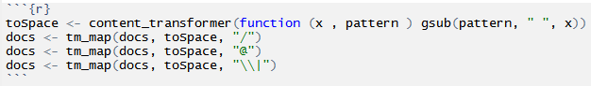
Transforming the data
Step 3: Transforming the data
The tm_map() function is used to remove unnecessary white space, to convert the text to lower case, to remove common stopwords like ‘the’, “we”.
Have a go at these.
© University of South Wales

Slide 24
Transforming the data
Step 3: Transforming the data
The information value of ‘stopwords’ is near zero due to the fact that they are so common in a language.
Removing this kind of words is useful before further analyses.
For ‘stopwords’, supported languages are danish, dutch, english, finnish, french, german, hungarian, italian, norwegian, portuguese, russian, spanish and swedish.
You could also remove numbers and punctuation with removeNumbers and removePunctuation arguments.
© University of South Wales

Slide 25
Transforming the data
Step 3: Transforming the data
Another important preprocessing step is to make a text stemming which reduces words to their root form.
In other words, this process removes suffixes from words to make it simple and to get the common origin.
For example, a stemming process reduces the words “moving”, “moved” and “movement” to the root word, “move”.
© University of South Wales

Slide 26
Document Term Matrix
Step 4: Build a document term matrix
Document matrix is a table containing the frequency of the words. Column names are words and row names are documents. The function TermDocumentMatrix() from text mining package can be used as follow.
Explore frequent terms and their associations. You can have a look at the frequent terms in the term-document matrix as follow.
© University of South Wales

Slide 27
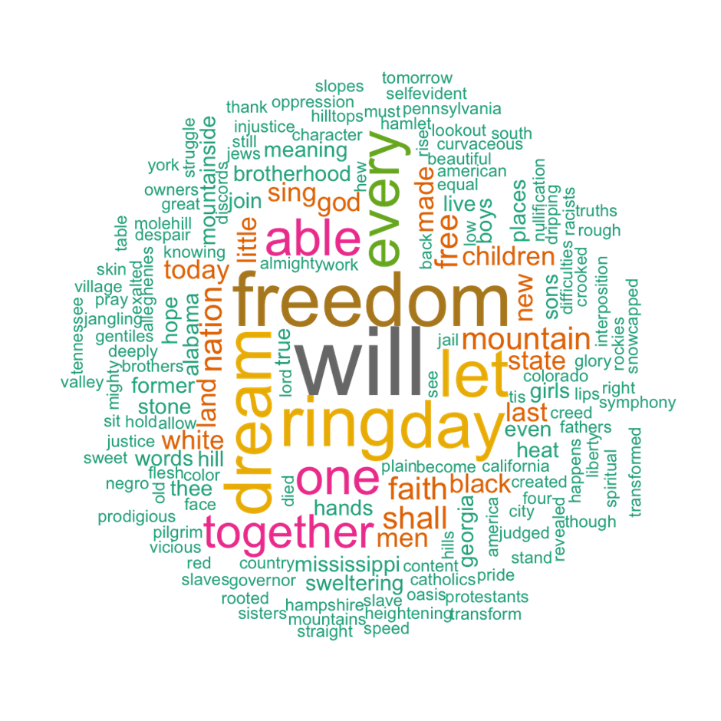
Word Cloud
Step 5: Build a word cloud
© University of South Wales

Slide 28
Word Cloud
Step 5: Build a word cloud
The above word cloud clearly shows that “Will”, “freedom”, “dream”, “day” and “together” are the five most important words in the “I have a dream speech” from Martin Luther King. Arguments of the word cloud generator function :
words : the words to be plotted
freq : their frequencies
min.freq : words with frequency below min.freq will not be plotted
max.words : maximum number of words to be plotted
random.order : plot words in random order. If false, they will be plotted in decreasing frequency
rot.per : proportion words with 90 degree rotation (vertical text)
colors : color words from least to most frequent. Use, for example, colors =“black” for single color.
© University of South Wales

